Slide 1

Full Stack Development
MERN Marvels Trio
Thejashree(4SF21CS176)
Sushma Y(4SF22CS415)
Swathi S D(4SF22CS416)

Slide 2
Introduction
"Flavorfare creations" – Your Ultimate Recipe Companion:
In a world where culinary creativity knows no bounds, Our Kitchen emerges as your go-to solution for all things culinary. Whether you're an aspiring chef, a seasoned home cook, or simply someone with an insatiable love for food, Our Kitchen is here to simplify and elevate your cooking experience. An extensive recipe app called Our Kitchen was created to aid foodies in their culinary explorations. Our Kitchen easily integrates into your daily routine, making it simpler than ever to find, create, and share recipes. It has a user-friendly interface and a multitude of functions.
Full Stack Development | 2

Slide 3
Problem Statement
A recipe application that allows users to easily search for, save, and organize their favorite recipes. The app should also provide features for creating and sharing their own recipes with the community. Additionally, the application should have a user login feature to save user preferences, and allow users to access their saved recipes across multiple devices.
Full Stack Development | 3

Slide 4
FeaĞures of Ğhe ApplicaĞion:
Recipe Search
Recipe details
Recipe Creation
Dietary restrictions
User Login
User Interface and Experience

Slide 5
Solution
System requirements for the project Software:
Chrome Visual Studio MongoDB Express React Node.js Bootstrap NPM
Postman API Platform
Hardware: Windows Intel CORe i5
500 MB storage
Languages:
CSS
Javascript HTML
Json
.
Full Stack Development | 5

Slide 6
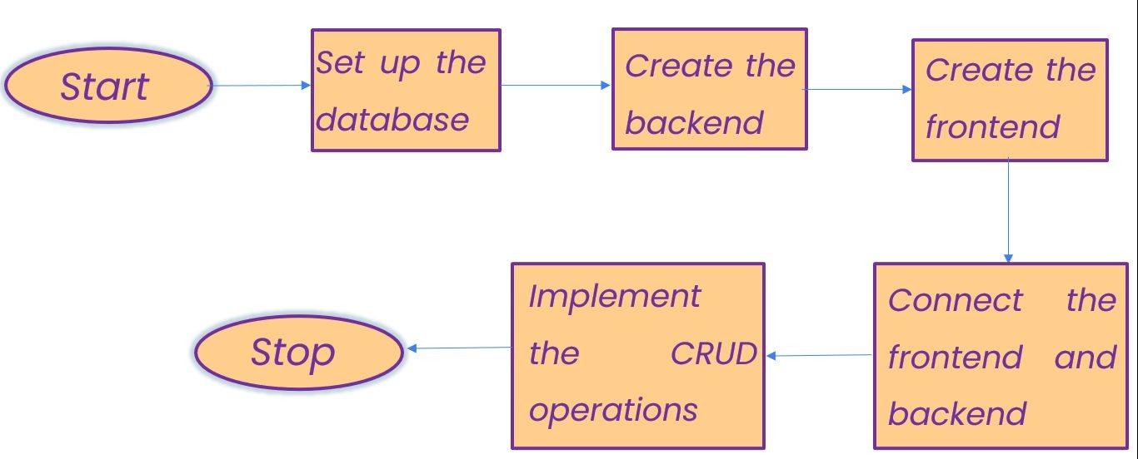

Slide 7
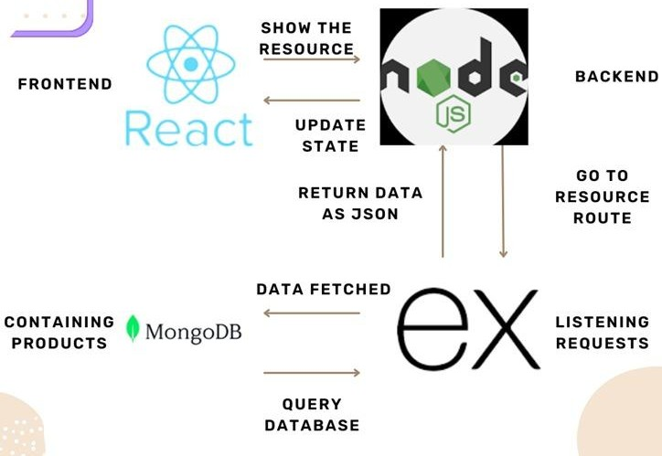

Slide 8
Frontend
Views
layouts
->main.ejs
About.ejs
Categories.ejs
Explore-latest.ejs
Login.ejs
Recipe.ejs
Register.ejs
Search.ejs
Submit-recipie.ejs

Slide 9
Backend
Controllers->AuthController.js
recipe.js Middlewares->AuthMiddleware.js
package.json Models->recipe.js
UserModel.js node_modules Routes->AuthRoute.js util->SecretToken.js index.js

Slide 10
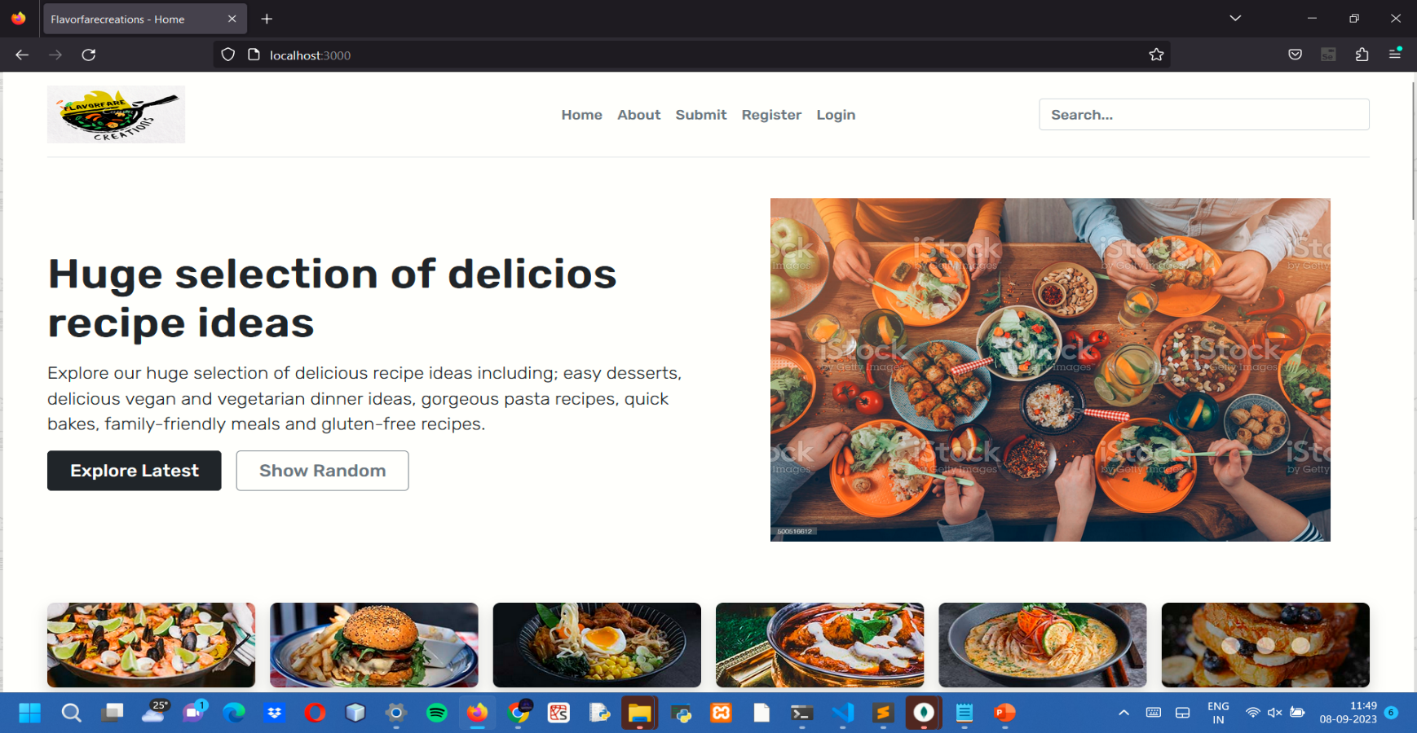

Slide 11
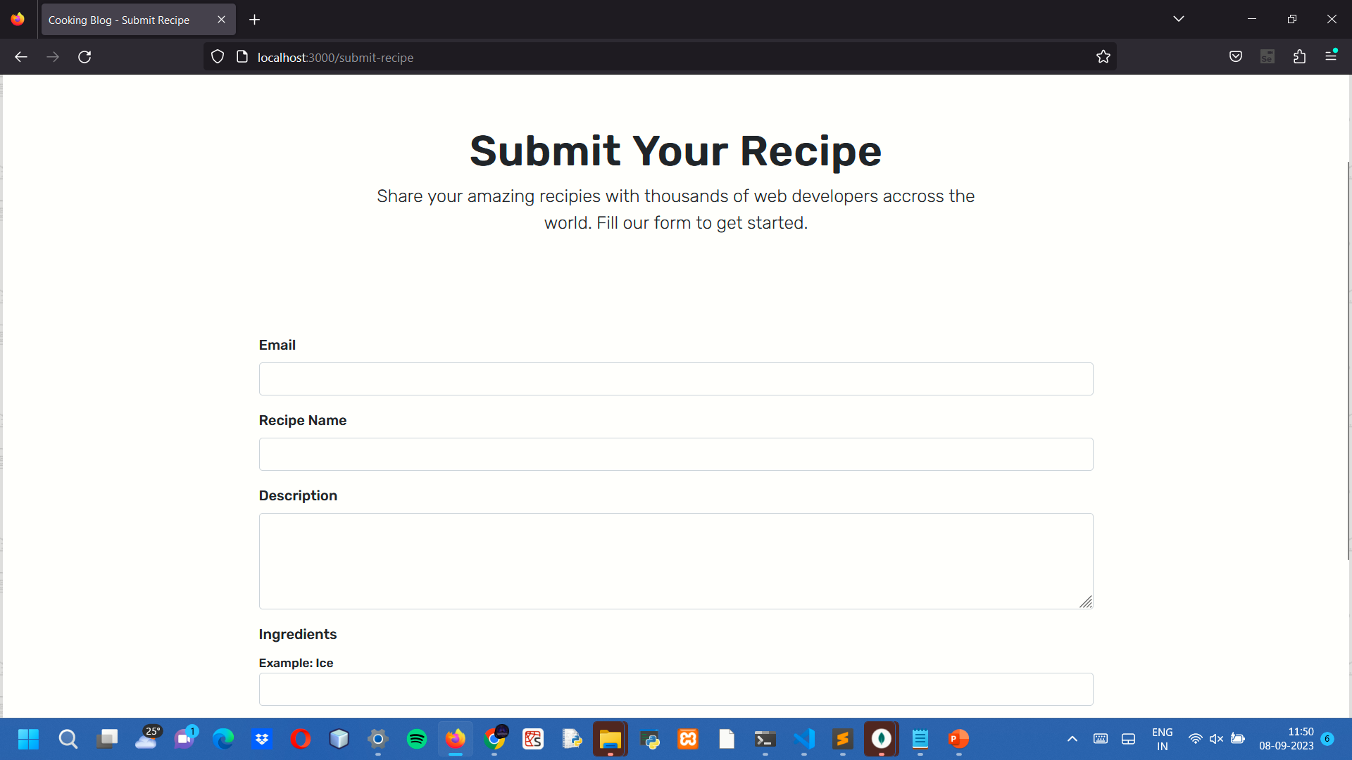

Slide 12
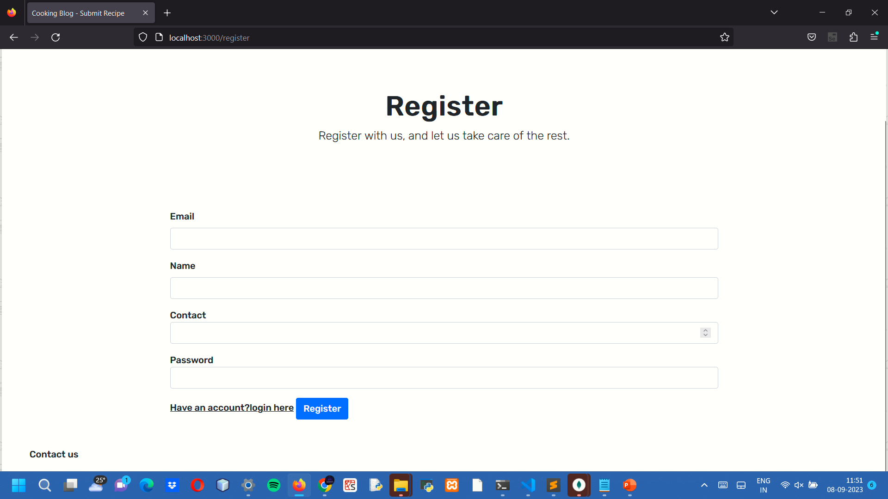

Slide 13
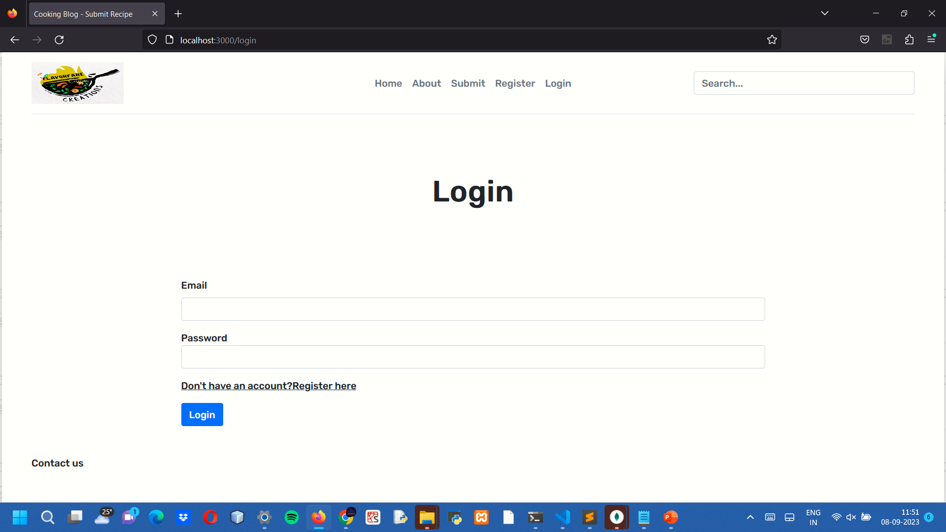

Slide 14
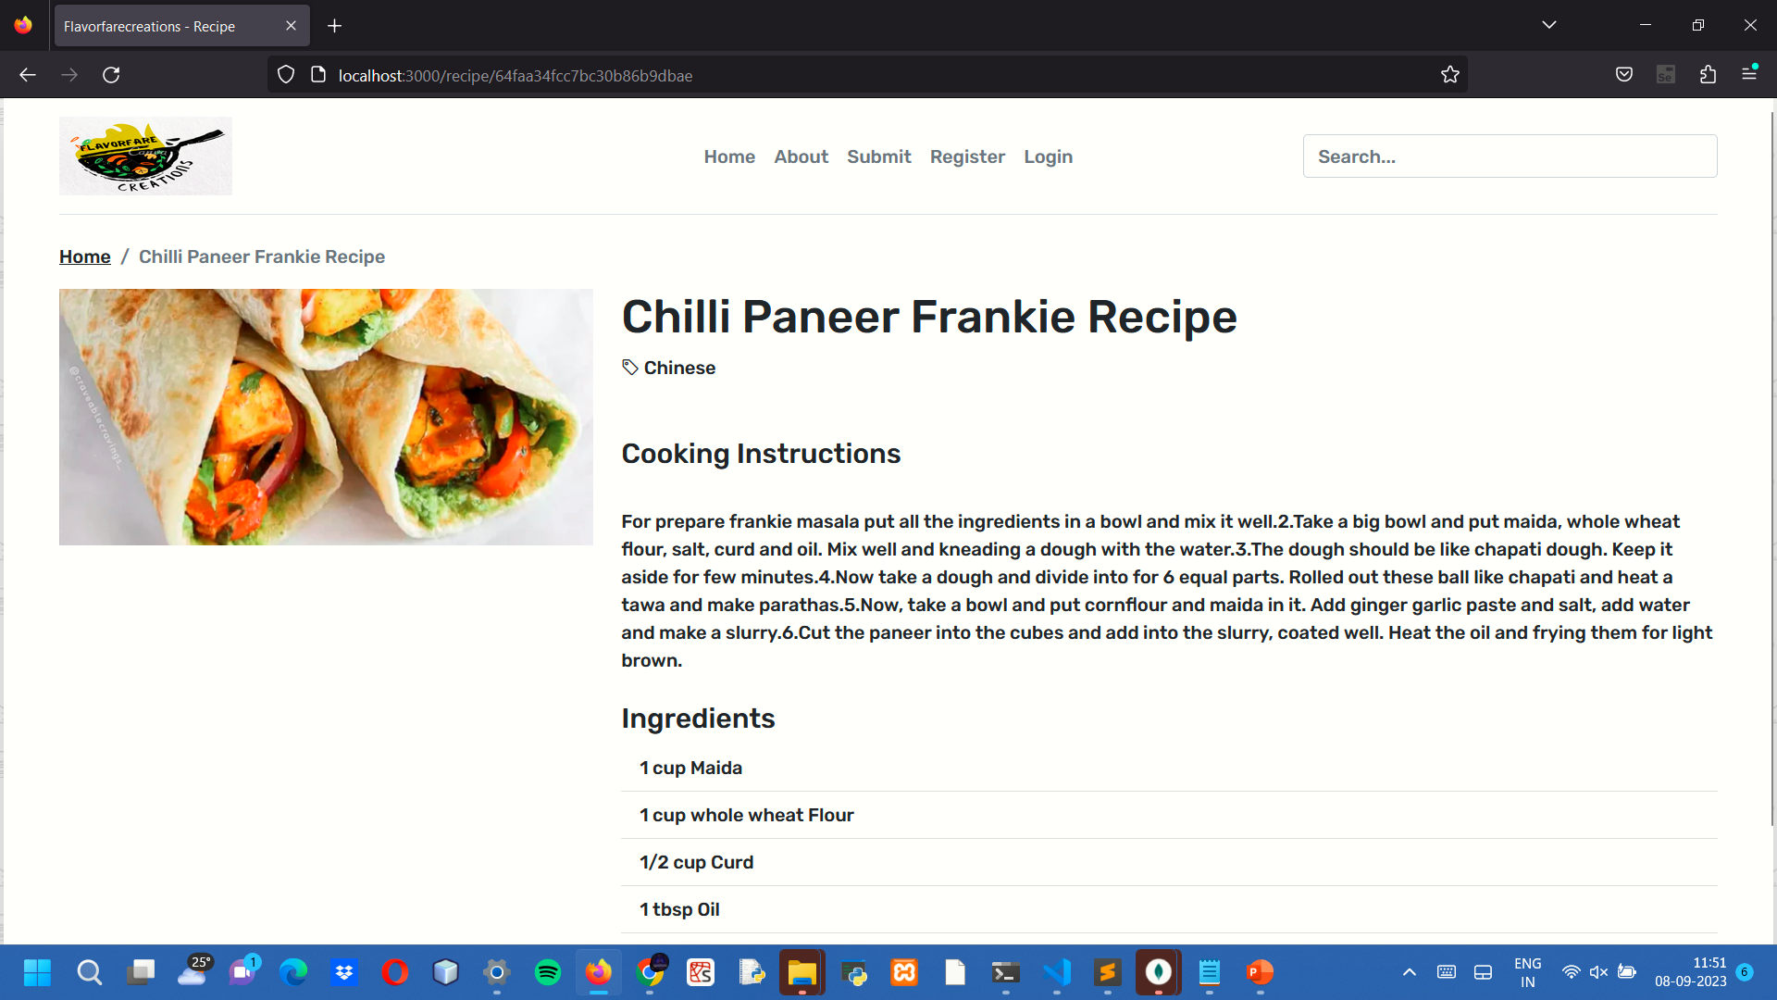

Slide 15
Conclusion
Streamlined Recipe Management: Our app simpliﬁes recipe discovery, storage, and
organization, giving users a hassle-free way to manage their culinary inspirations.
Community Engagement and Cross-Device Accessibility: Connect with fellow food enthusiasts, share your culinary creations, and access your saved recipes effortlessly on any device, all within a user-friendly, login-enabled platform.
Full Stack Development | 11

Slide 16
References
https://www.mongodb.com/docs/
https://expressjs.com/
https://react.dev/learn
https://nodejs.org/en/docs/guides
https://www.w3schools.com/
https://getbootstrap.com/docs/5.0/getting-started/introduction/
https://www.npmjs.com/
Full Stack Development | 12

Slide 17
Thank You

